Slide 1
Lucretia Mott and Elizabeth Cady Stanton

Slide 2
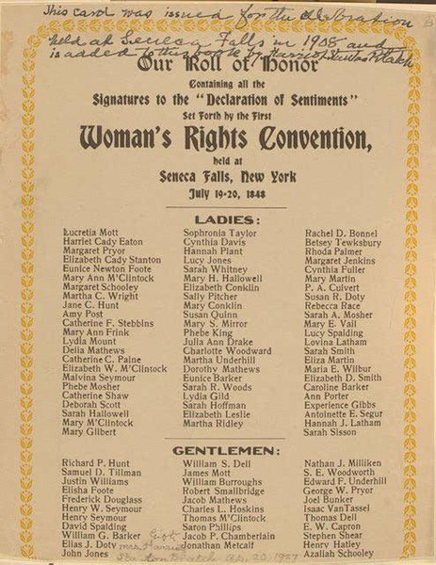
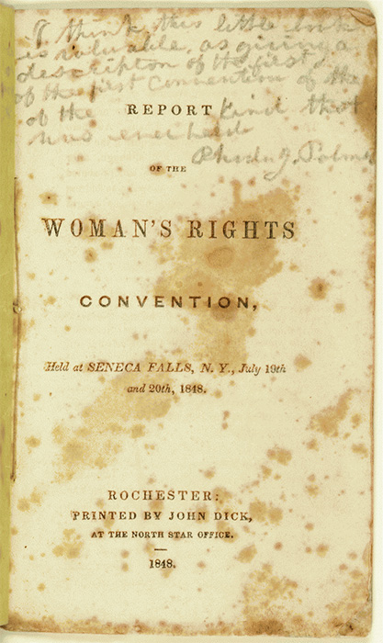

Slide 3
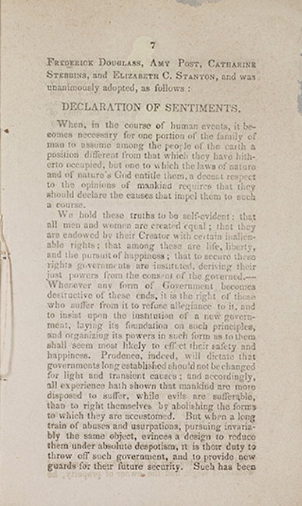
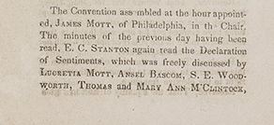
Declaration Sentiments,
Seneca Falls Convention, July 1848

Slide 4
The history of mankind is a history of repeated injuries and usurpations on the part of man toward woman, having in direct object the establishment of an absolute tyrranny over her. To prove this, let facts be submitted to a candid world.
He has never permitted her to exercise her inalienable right to the elective franchise.
He has compelled her to submit to laws, in the formation of which she had no voice.
He has withheld from her rights which are given to the most ignorant and degraded men--both natives and foreigners.
Having deprived her of this first right of a citizen, the elective franchise, thereby leaving her without representation in the halls of legislation, he has oppressed her on all sides.
He has made her, if married, in the eye of the law, civilly dead.
He has taken from her all right in property, even to the wages she earns.
He has made her, morally, an irresponsible being, as she can commit many crimes with impunity, provided they be done in the presence of her husband. In the covenant of marriage, she is compelled to promise obedience to her husband, he becoming, to all intents and purposes, her master--the law giving him power to deprive her of her liberty, and to administer chastisement.
He has so framed the laws of divorce, as to what shall be the proper causes, and in case of separation, to whom the guardianship of the children shall be given, as to be wholly regardles of the happiness of women--the law, in all cases, going upon a flase supposition of the supremacy of man, and giving all power into his hands.

Slide 5
After depriving her of all rights as a married woman, if single, and the owner of property, he has taxed her to support a government which recognizes her only when her property can be made profitable to it.
He has monopolized nearly all the profitable employments, and from those she is permitted to follow, she receives but a scanty remuneration. He closes against her all the avenues to wealth and distinction which he considers most homorable to himself. As a teacher of theoloy, medicine, or law, she is not known.
He has denied her the facilities for obtaining a thorough education, all colleges being closed against her.
He allows her in church, as well as state, but a suborinate position, claiming apostolic authority for her exclusion from the ministry, and, with some exceptions, from any public participation in the affairs of the church.
He has created a false public sentiment by giving to the world a different code of morals for men and women, by which moral delinquencies which exclude women from society, are not only tolerated, but deemed of little account in man.
He has usurped the prerogative of Jehovah himself, claiming it as his right to assign for her a sphere of action, when that belongs to her conscience and to her God.
He has endeavored, in every way that he could, to destroy her conficence in her own powers, to lessen her self-respect, and to make her willing to lead a dependent and abject life.

Slide 7
The Fifteenth Amendment declared that voting “shall not be denied or abridged . . . on account of race, color, or previous condition of servitude.”

Slide 8
“All persons born or naturalized in the United States, and subject to the jurisdiction thereof, are citizens of the United States and of the State wherein they reside.”
Privileges and Immunities Clause of the 14th Amendment
“No State shall make or enforce any law which shall abridge the privileges or immunities of citizens of the United States....”

Slide 10
The Slaughter-House Cases, 83 U.S. (16 Wall.) 36 (1873)
was a landmark U.S. Supreme Court decision that held that the Privileges or Immunities Clause of the Fourteenth Amendment to the U.S. Constitution only protects the legal rights that are associated with federal citizenship, not those that pertain to state citizenship. The decision consolidated two similar cases.
5-4 ruling by the court.
In a dissenting opinion, Associate Justice Stephen J. Field wrote that Miller's opinion effectively rendered the Fourteenth Amendment a "vain and idle enactment."

Slide 13
Hallie Quinn Brown,
National Association of Colored Women

Slide 14
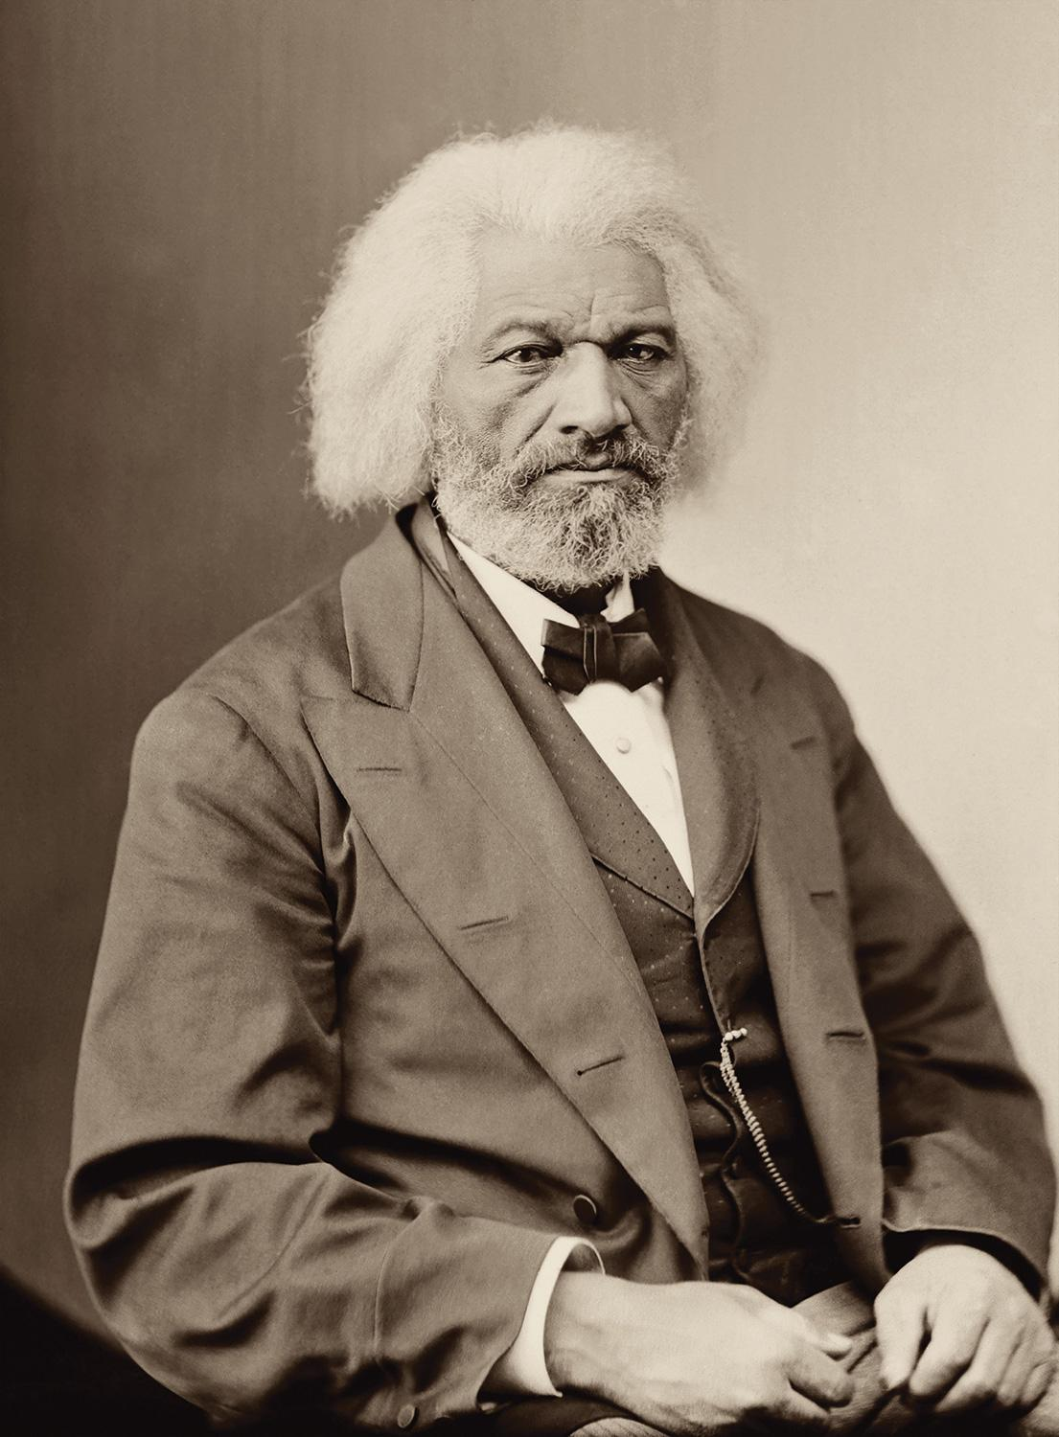

Slide 15
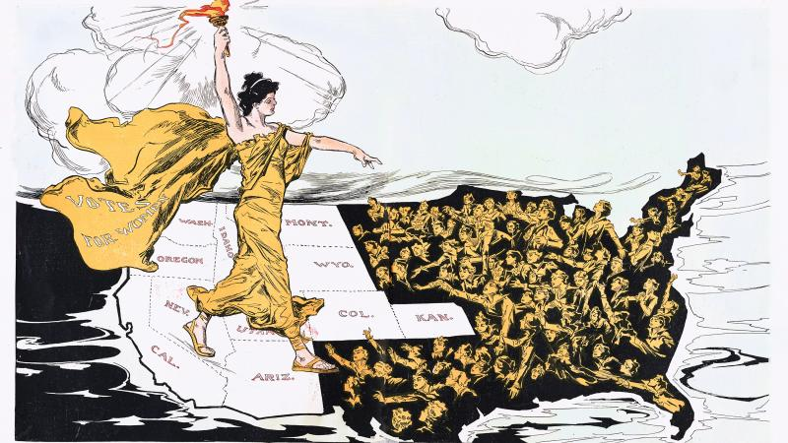

Slide 16
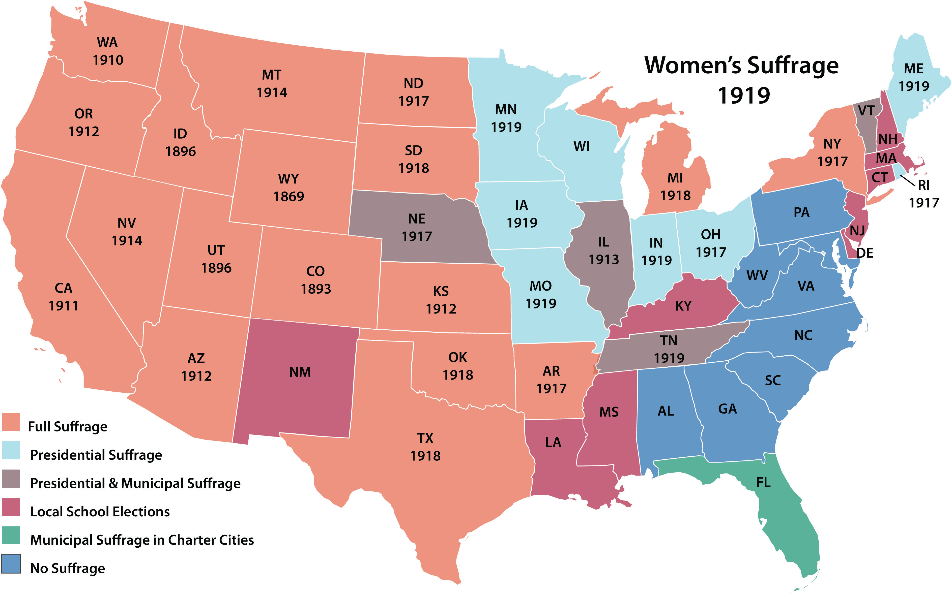

Slide 18
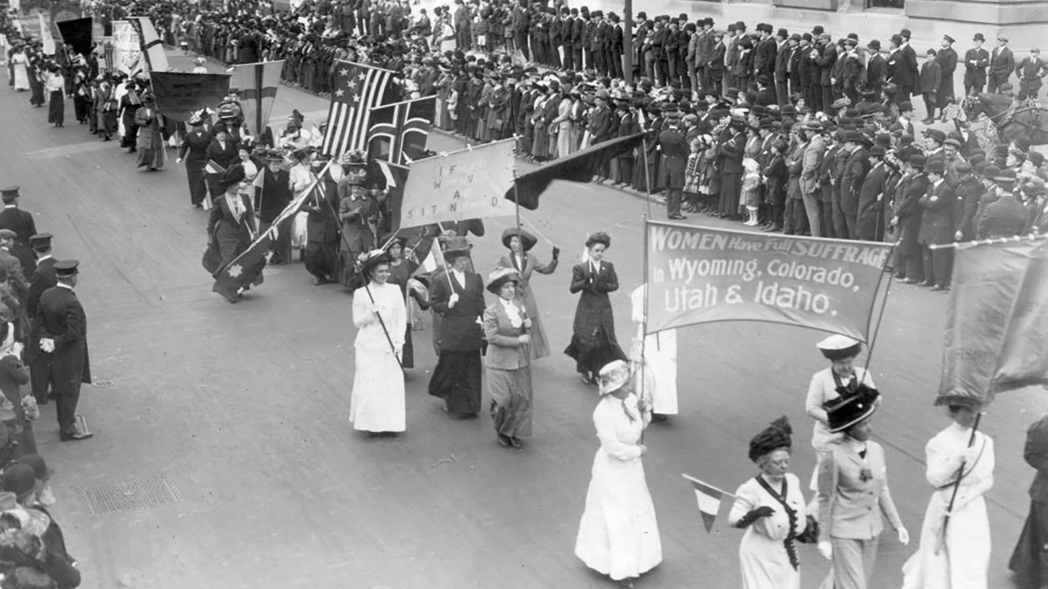

Slide 19
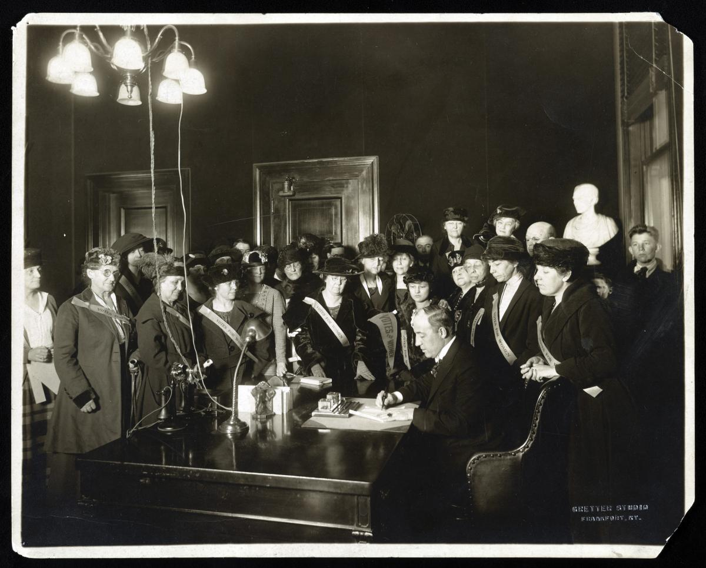

Slide 20
